Slide 1




ME 609
Programming Project
Phase 2
MULTI-Variable Optimization Using
CONJUGATE GRADIENT Method,
BOUNDING PHASE and GOLDEN SECTION SEARCH METHOD
Presented By:
Group - 35
DUSHYANT Pratap singh - 244103101

Slide 2
Result on different initial guess for Minimization :
1. Sum square function
Sum Squares Function
Initial Guess |  |  |  |  |  | Optimum Value
x1 | x2 | x3 | x4 | x5 | Iteration | x1* | x2* | x3* | x4* | x5* | f(x*)
1.76271 | -2.30554 | 4.635298 | 1.618643 | -2.71399 | 13 | 0 | 0 | 0 | 0 | 0 | 0
2.326477 | 0.69924 | 1.52114 | 4.97062 | 0.79393 | 12 | 0 | 0 | 0 | 0 | 0 | 0
-1.16988 | -0.90768 | 4.894056 | 4.880305 | 0.002656 | 15 | 0 | 0 | 0 | 0 | 0 | 0
-0.77768 | 2.764616 | 2.089908 | 2.294601 | -0.1661 | 11 | 0 | 0 | 0 | 0 | 0 | 0
2.471794 | 0.467358 | 3.985278 | -4.62686 | -3.81934 | 16 | 0 | 0 | 0 | 0 | 0 | 0
-1.7899 | 2.009905 | 2.104595 | 3.792772 | 1.208318 | 13 | 0 | 0 | 0 | 0 | 0 | 0
2.687113 | -3.32651 | 0.412981 | -3.86684 | -1.22613 | 14 | 0 | 0 | 0 | 0 | 0 | 0
-0.03078 | 0.947373 | -4.31873 | -3.29119 | -4.28716 | 12 | 0 | 0 | 0 | 0 | 0 | 0
4.663111 | 0.837994 | -3.23588 | -3.69308 | 3.769646 | 15 | 0 | 0 | 0 | 0 | 0 | 0
2.358041 | -3.14838 | -5.00156 | -2.2521 | 2.743365 | 10 | 0 | 0 | 0 | 0 | 0 | 0

Slide 3

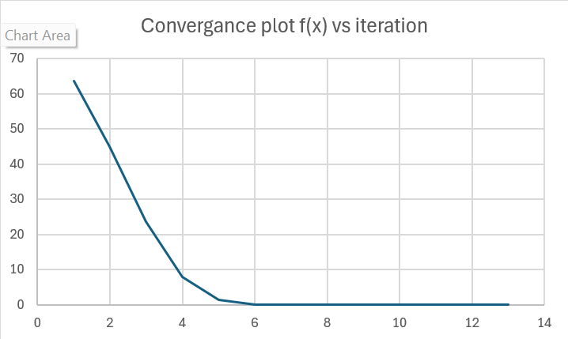
GRAPHICAL PLOTS

Slide 4
2. ROSENBROCK FUNCTION
Rosenrock Function
Initial Guess |  |  |  | Optimal Value
x1 | x2 | x3 | Iteration | x1* | x2* | x3* | f(x*)
-0.87334 | -0.89984 | -0.72159 | 23 | 0.999882 | 0.999765 | 0.99953 | 0
0.407575 | 1.72049 | 1.850494 | 22 | 1.0002 | 1.0004 | 1.000802 | 0
1.377355 | -1.03709 | 0.214069 | 24 | 0.999818 | 0.999635 | 0.999267 | 0
-0.25032 | 0.540079 | -1.49186 | 25 | 1.00019 | 1.000381 | 1.000763 | 0
-1.70574 | -1.55911 | 0.099691 | 27 | 1.000035 | 1.000069 | 1.000137 | 0
0.4057 | 0.967342 | 0.72496 | 33 | 1.000045 | 1.00009 | 1.00018 | 0
0.019938 | 1.108346 | -0.74796 | 20 | 0.999971 | 0.999941 | 0.999881 | 0
-0.65633 | 2.03175 | -0.56921 | 21 | 1.000176 | 1.000353 | 1.000709 | 0
-0.52033 | 1.56011 | -0.29007 | 25 | 1.000164 | 1.000329 | 1.000661 | 0
1.673239 | -0.3412 | -0.3642 | 23 | 0.99992 | 0.999838 | 0.999677 | 0

Slide 5
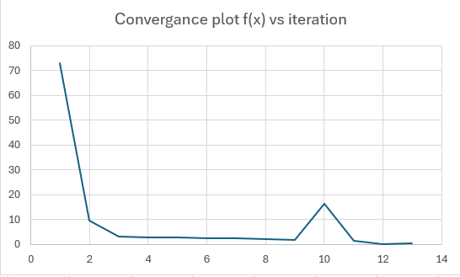
GRAPHICAL PLOTS

Slide 6
3. DIXON PRICE FUNCTION
Dixon Price Function
Initial Guess |  |  |  |  | Optimal Value
x1 | x2 | x3 | x4 | Iteration | x1* | x2* | x3* | x4* | f(x*)
7.665334 | -7.90704 | -5.9331 | -4.08307 | 14 | 0.999897 | 0.707064 | 0.594607 | 0.545265 | 0
-4.0849 | -5.01816 | 0.884732 | -6.18152 | 15 | 0.999896 | 0.707054 | 0.594576 | 0.545244 | 0
-8.74203 | 4.77279 | -4.53902 | 4.025086 | 21 | 0.999809 | 0.707032 | 0.594588 | 0.54524 | 0
9.445784 | -8.08771 | -3.64422 | -7.86493 | 10 | 0.999829 | 0.707041 | 0.59458 | 0.545234 | 0
-8.80795 | -1.78991 | -2.55409 | -4.88754 | 16 | 1.000185 | 0.707183 | 0.594664 | 0.545289 | 0
6.428724 | 0.961028 | 7.929014 | 5.121921 | 15 | 0.999586 | 0.706944 | 0.594527 | 0.545216 | 0
1.990112 | -8.02484 | 5.54857 | -1.00009 | 22 | 0.999948 | 0.707079 | 0.594584 | 0.545257 | 0
6.726585 | -7.38884 | -7.42363 | 0.707724 | 14 | 1.000024 | 0.707126 | 0.594624 | 0.545265 | 0
7.313761 | 5.002289 | -5.98071 | -2.69021 | 12 | 1.000097 | 0.707145 | 0.594605 | 0.54525 | 0
1.861324 | -6.26881 | -7.88629 | -4.00983 | 18 | 0.999993 | 0.707113 | 0.594614 | 0.54526 | 0

Slide 7
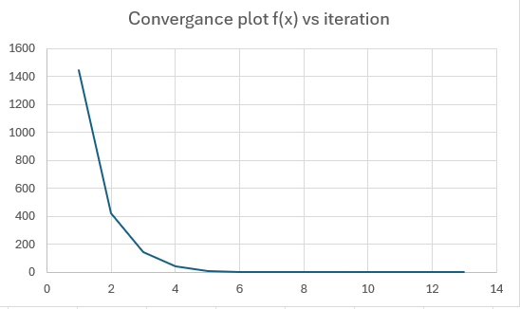
GRAPHICAL PLOTS

Slide 8
4. TRID FUNCTION
Trid Function
Initial Guess |  |  |  |  |  |  | Optimum Value
x1 | x2 | x3 | x4 | x5 | x6 | Iteration | x1* | x2* | x3* | x4* | x5* | x6* | f(x*)
15.9032 | 12.55226 | 2.980682 | 18.52022 | -24.4552 | 21.22733 | 16 | 6.000128 | 9.999964 | 11.99998 | 12.00015 | 10.00019 | 5.999946 | -50
-26.9821 | -3.02023 | -4.29029 | -29.6893 | -17.7863 | -16.8898 | 12 | 5.999485 | 9.998989 | 11.99894 | 11.99886 | 9.999122 | 5.999506 | -50
24.2201 | -19.2519 | 31.56139 | 35.48802 | -18.0566 | 29.88702 | 13 | 6.000146 | 10.00031 | 12.0004 | 12.00044 | 10.00033 | 6.000209 | -50
-23.3873 | -26.3515 | -14.765 | -14.598 | 3.134495 | -5.80425 | 12 | 5.999836 | 9.999973 | 12.00013 | 11.99982 | 9.999935 | 6.000115 | -50
16.14051 | -4.05738 | 35.76928 | -14.5518 | 16.38441 | -14.6507 | 15 | 6.000224 | 10.00009 | 11.99991 | 11.99963 | 9.999822 | 5.999935 | -50
30.29353 | 33.02701 | 22.76107 | 15.14072 | 35.09909 | 14.40901 | 16 | 6.000084 | 9.999994 | 11.99982 | 11.99956 | 10.00002 | 6.000259 | -50
-0.55263 | 6.973235 | -12.961 | -35.1013 | 31.16147 | 30.82308 | 14 | 5.999941 | 9.999845 | 11.99992 | 12.00006 | 10.00021 | 6.000152 | -50
24.76064 | 13.69488 | -15.7692 | 25.2946 | -6.0108 | -1.45354 | 11 | 5.999376 | 9.998717 | 11.99838 | 11.99862 | 9.999085 | 5.999402 | -50
-33.2951 | -15.1319 | 30.33308 | 12.13697 | 6.008606 | 8.920072 | 11 | 6.000213 | 10.00029 | 12.00059 | 12.0005 | 10.00032 | 6.000138 | -50
-10.6977 | -7.20615 | -12.1238 | 2.101749 | 20.59011 | -1.12613 | 18 | 6.000026 | 9.999956 | 11.99963 | 11.99937 | 9.99939 | 5.999747 | -50

Slide 9
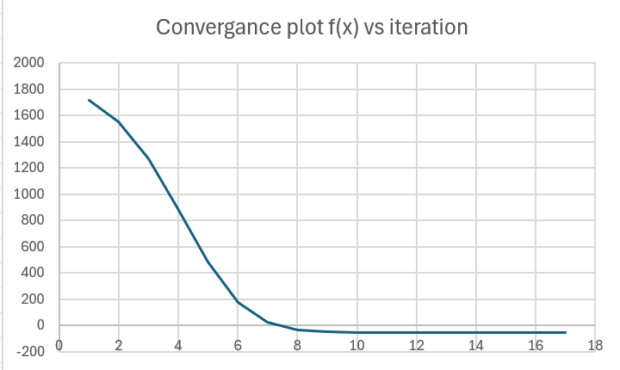
GRAPHICAL PLOTS

Slide 10
5. ZAKHAROV FUNCTION
Zakharov Function
Initial Guess |  |  | Optimum Value
x1 | x2 | Iteration | x1* | x2* | f(x*)
5.649281 | -2.88369 | 21 | 0 | 0 | 0
7.092196 | -4.10505 | 16 | 0 | 0 | 0
9.218116 | 0.204474 | 20 | 0 | 0 | 0
6.422468 | 3.530686 | 15 | 0 | 0 | 0
6.484725 | 6.223792 | 20 | 0 | 0 | 0
9.898831 | 3.475753 | 15 | 0 | 0 | 0
-2.08075 | 2.06534 | 14 | 0 | 0 | 0
-2.73309 | 0.270394 | 13 | 0 | 0 | 0
8.174841 | 8.194067 | 12 | 0 | 0 | 0
-3.16706 | -0.61449 | 10 | 0 | 0 | 0

Slide 11
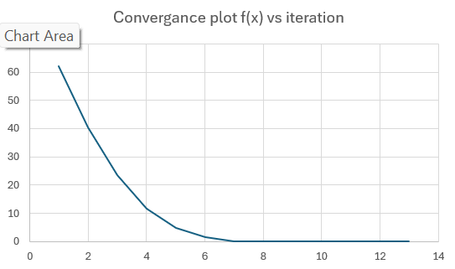
GRAPHICAL PLOTS

Slide 12

CONCLUSION
Marquart’s method is computationally expensive due to formation of Hessian matrix and inverse of it, but it takes less number of iterations to converge.

